Slide 1

Theresa Sipiho
Investment & Export Promotion Attache
Namibia’s Tourism Sector
24 April 2025 | Maun, Botswana

Slide 2
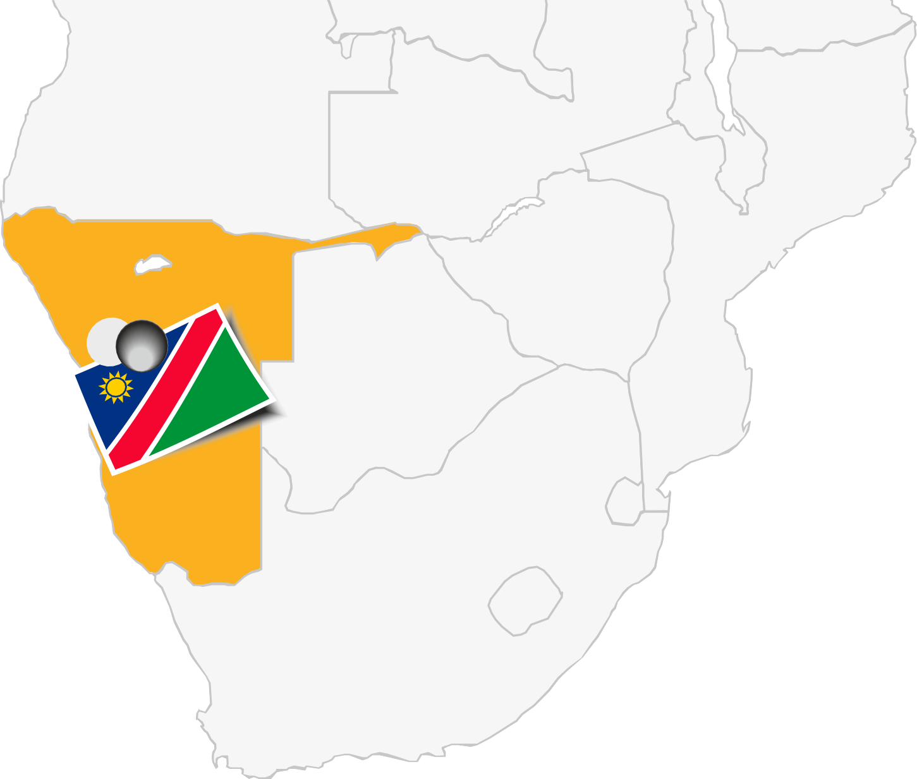
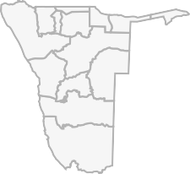







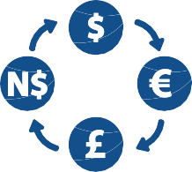







NAMIBIA AT A GLANCE
Capital City: Windhoek
Population
3.01 million
824,292
km2
US$ 5,031.10
Per Capita
Multiparty Parliament
Democratic Constitution
Imports:
US$ 7.9 billion
Exports: US$ 6.3 billion
GDP
US$12.91 Billion
US$/ NAD 18.32
(12/08/2024)
Climate:
Arid and semi-arid
English Business Language
Located on the southwestern coast of Africa, borders Angola, Botswana, South Africa, Zambia and Zimbabwe

Slide 3
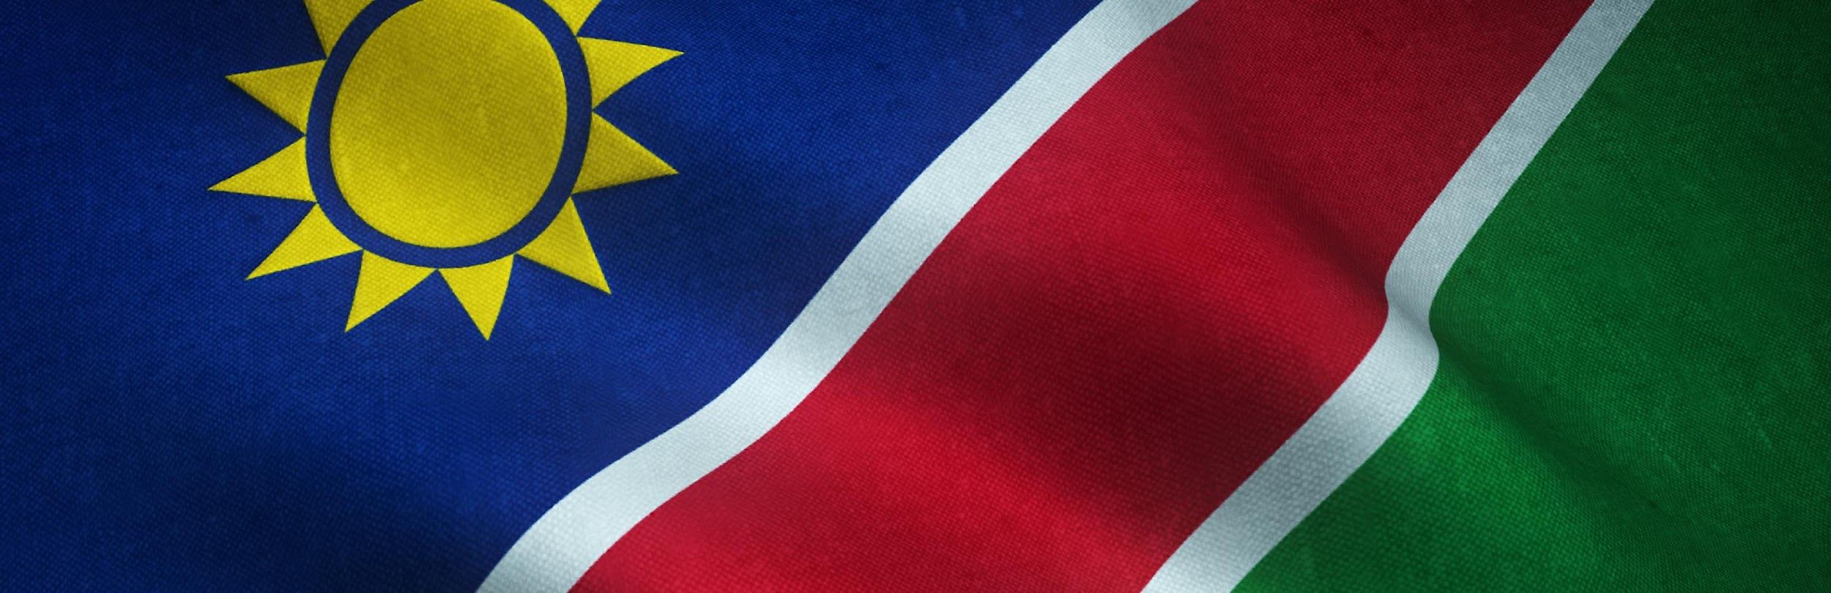

ECONOMIC DRIVERS

Slide 4

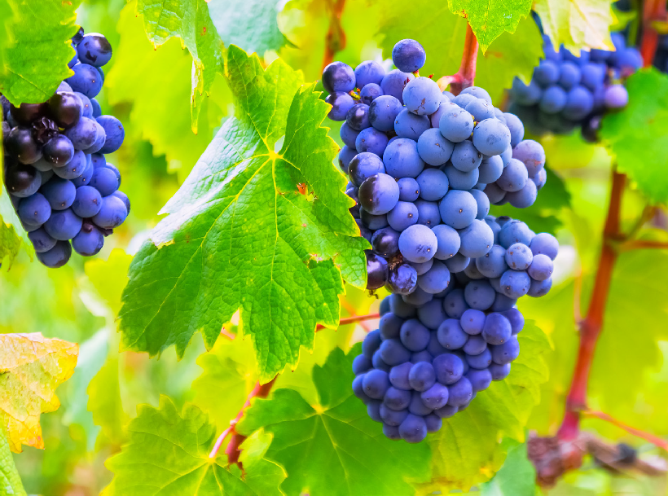

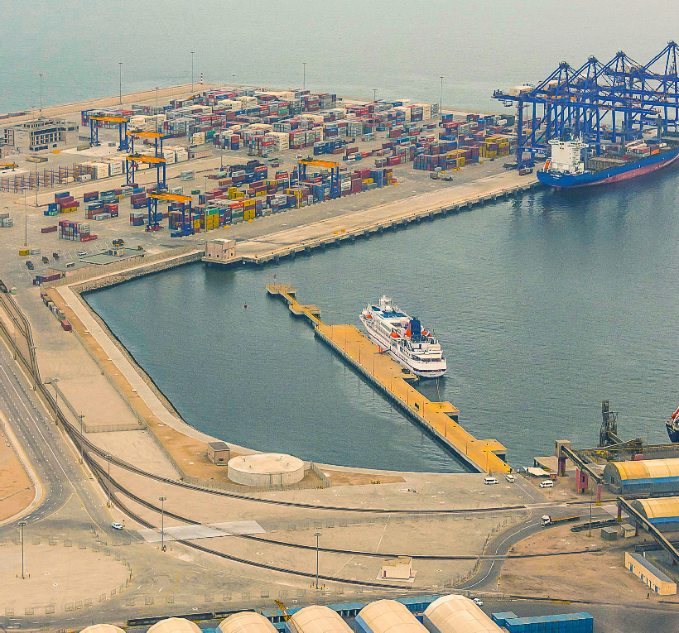

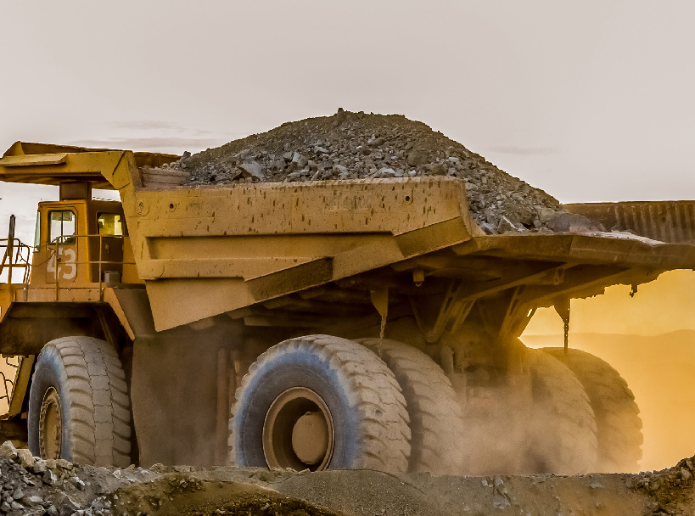


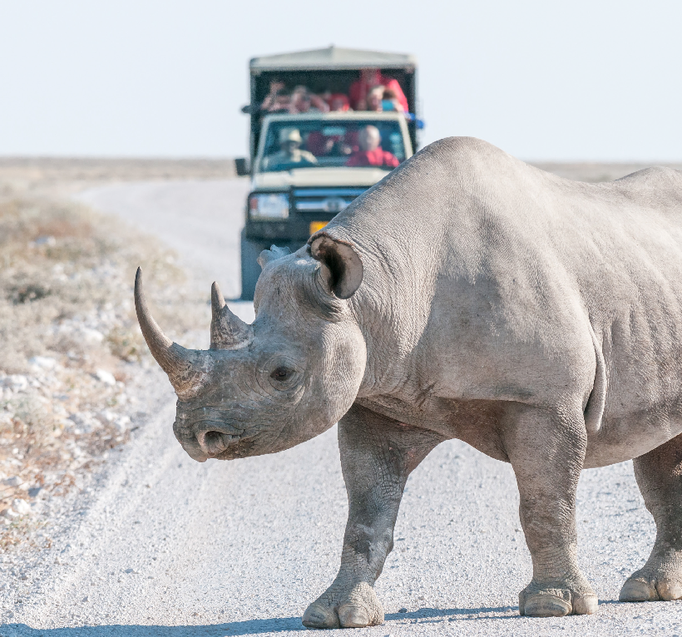

PRIORITY SECTORS
Energy (Renewable, GH2, O&G etc.)
Chemicals & Basic Materials
Services
(Digital and Global Business)
Food Industry
Transport and Logistics
Metals, Mining & Adjacent Industries
Machinery & Electronics
Communication & Technology
Tourism
Culture and Creative Industry

Slide 5
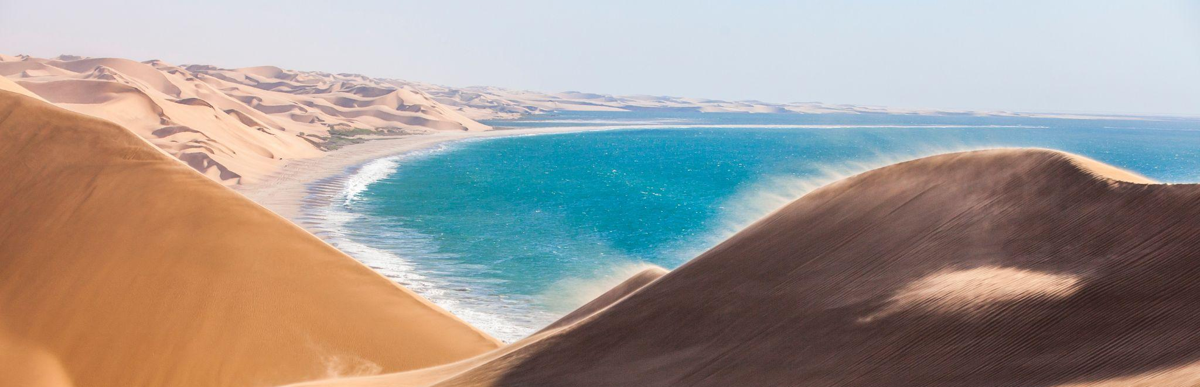
NAMIBIA’S TOURISM OFFERING

Slide 6
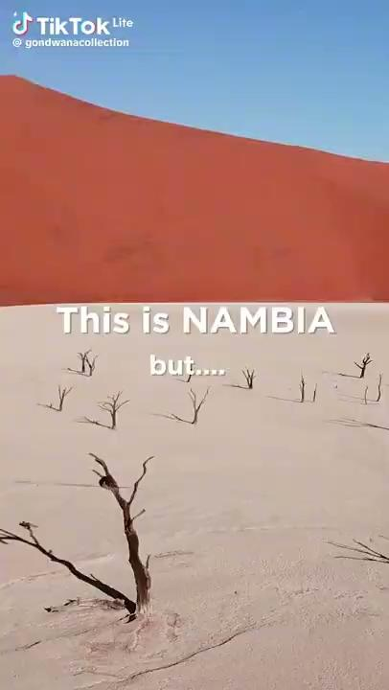
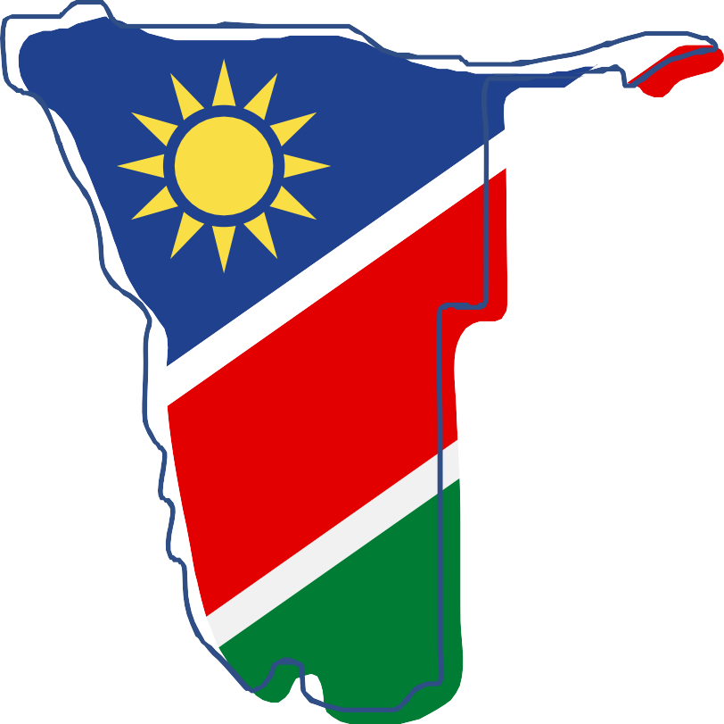

NAMIBIA: LAND OF DIVERSITY
Notes:
LAND OF DIVERSITY
IT IS THAT DIVERSITY THAT WILL ENABLE US TO DO GREAT THINGS…
DOUBLE OUR GDP IN NEXT 10 YEARS - FLON STATEMENT
IF YOU HEAR NOTHING ELSE, KNOW YOU CAN GROW YOUR BUSINESS WITH NAMIBIA

Slide 7




NAMIBIA IS KNOWN FOR
Consistently ranked among the top 10 safest destinations in Africa
Namibia is home to Africa’s largest canyon, the Fish River Canyon
The largest meteorite in the world was discovered in Namibia
Among the top 10 most peaceful countries in Africa
Namibia is home to Earth’s largest underground lake
Nearly half of Namibia’s land is under conservation management
The Namib desert is the world’s oldest desert
Namibia has the world’s largest black rhino population
Namibia was the first country in Africa to incorporate environmental protection into the national constitution
Namibia is home to Africa’s largest canyon, the Fish River Canyon
Namibia is the world’s leading source of marine diamonds

Slide 8
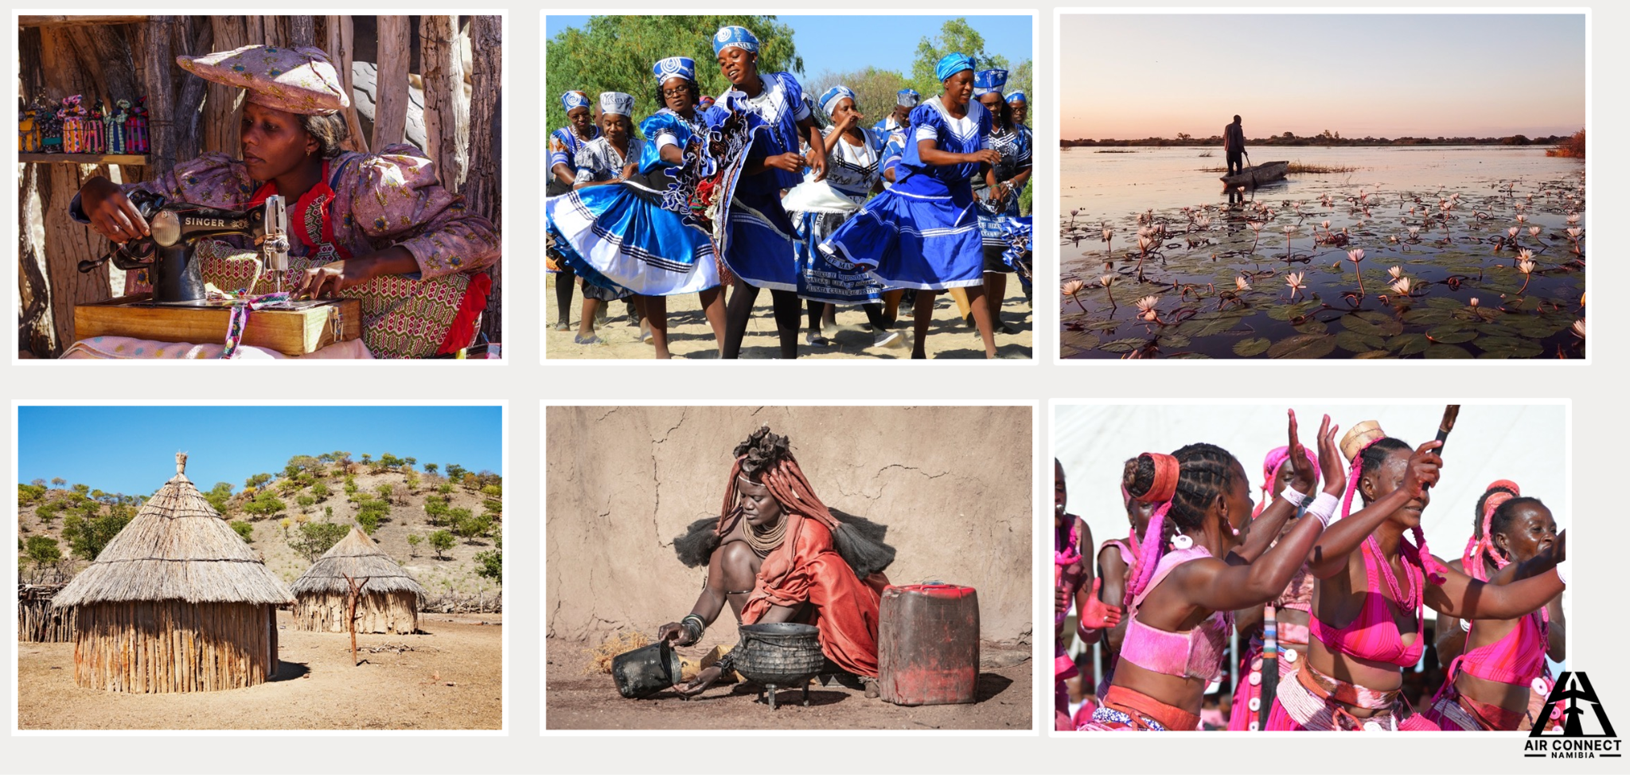
CULTURE & HERITAGE

Slide 9
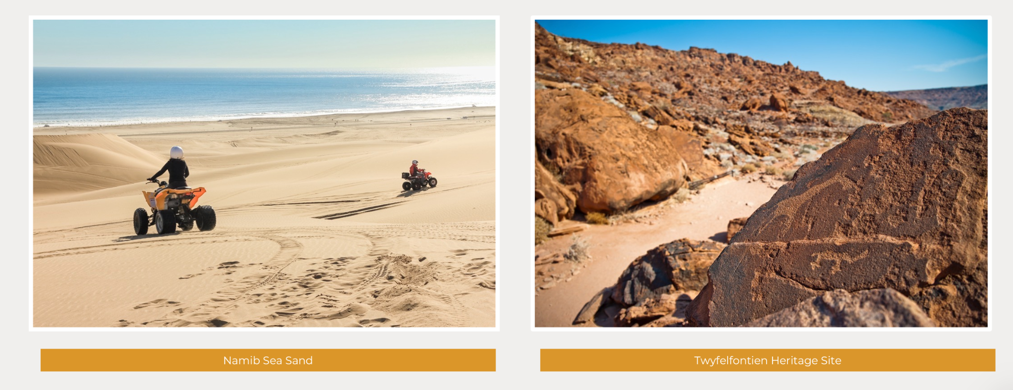
NAMIBIA’S UNESCO WORLD HERITAGE
Namib Sea Sand
Twyfelfontein Heritage Site

Slide 10
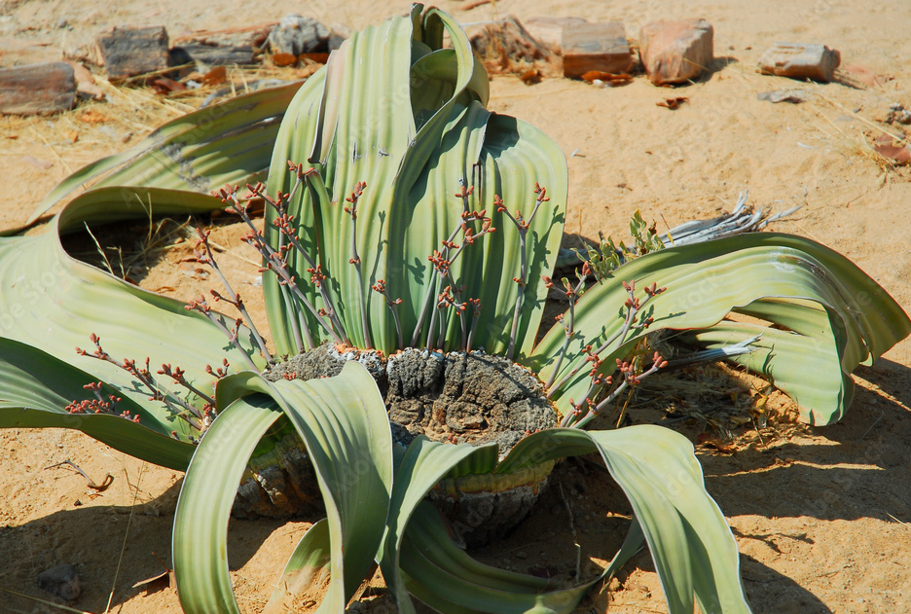
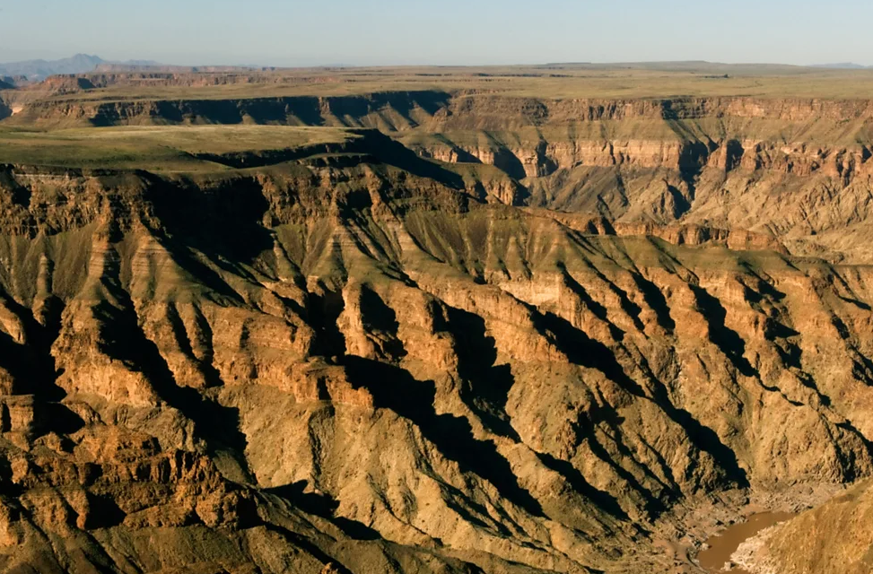
NAMIBIA’S NATURAL WONDERS
Welwitschia Mirabilis
Fish River Canyon

Slide 11
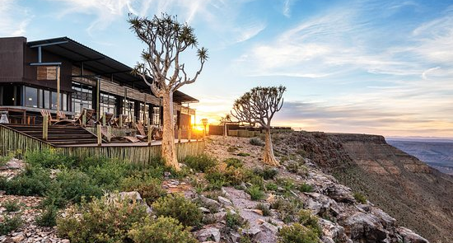
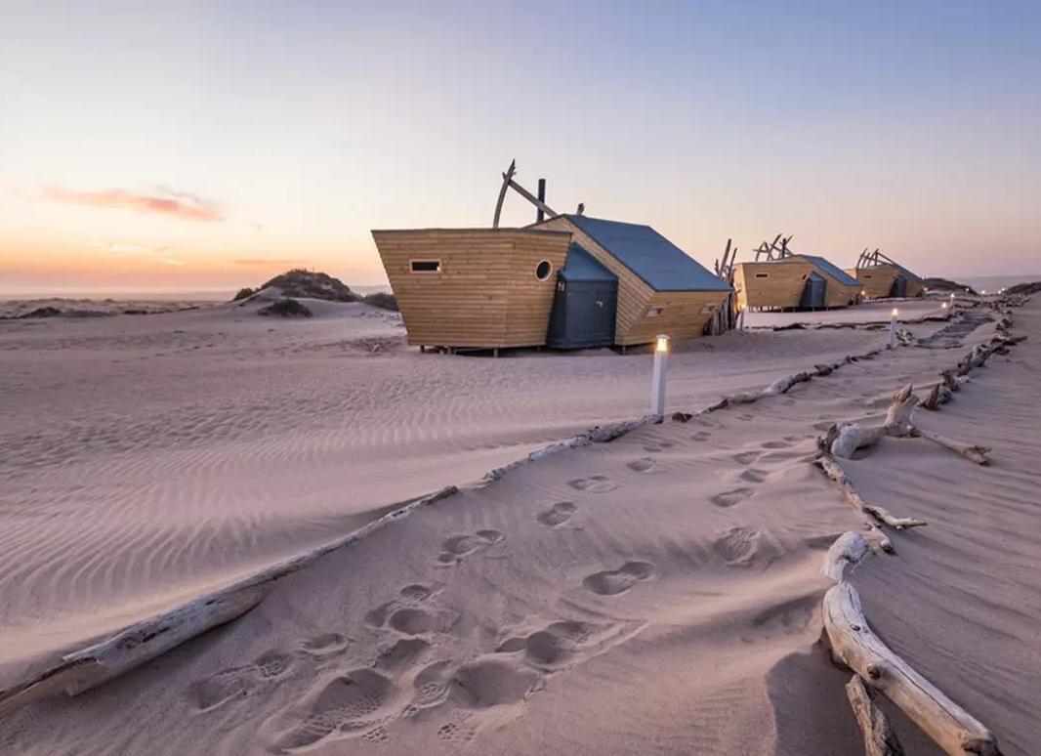
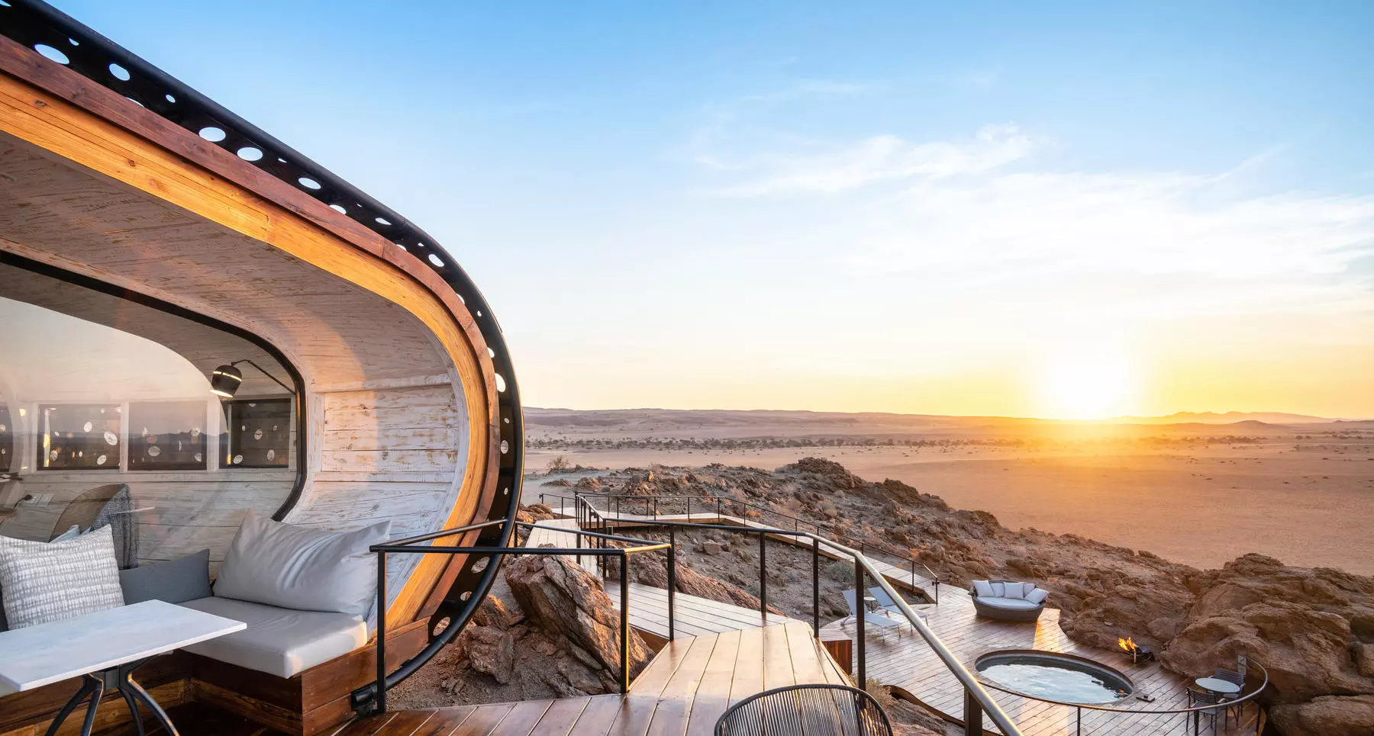
REST & RELAXATION - TOP LODGES

Slide 12
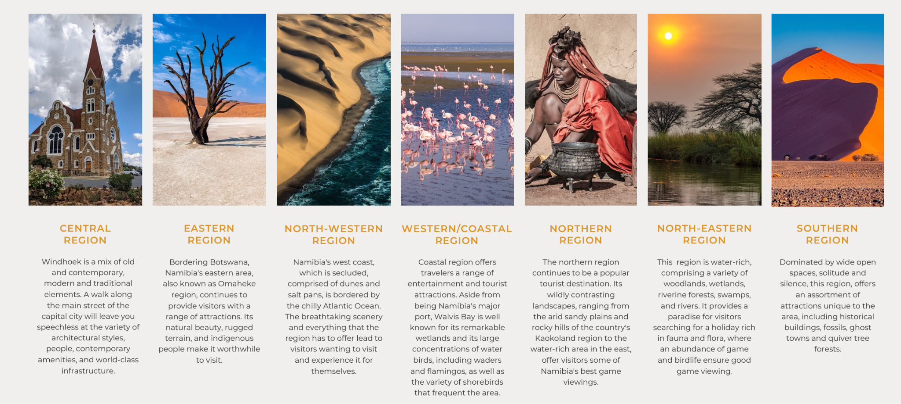
NAMIBIA’S 7-TOURISM CLUSTER REGIONS

Slide 13
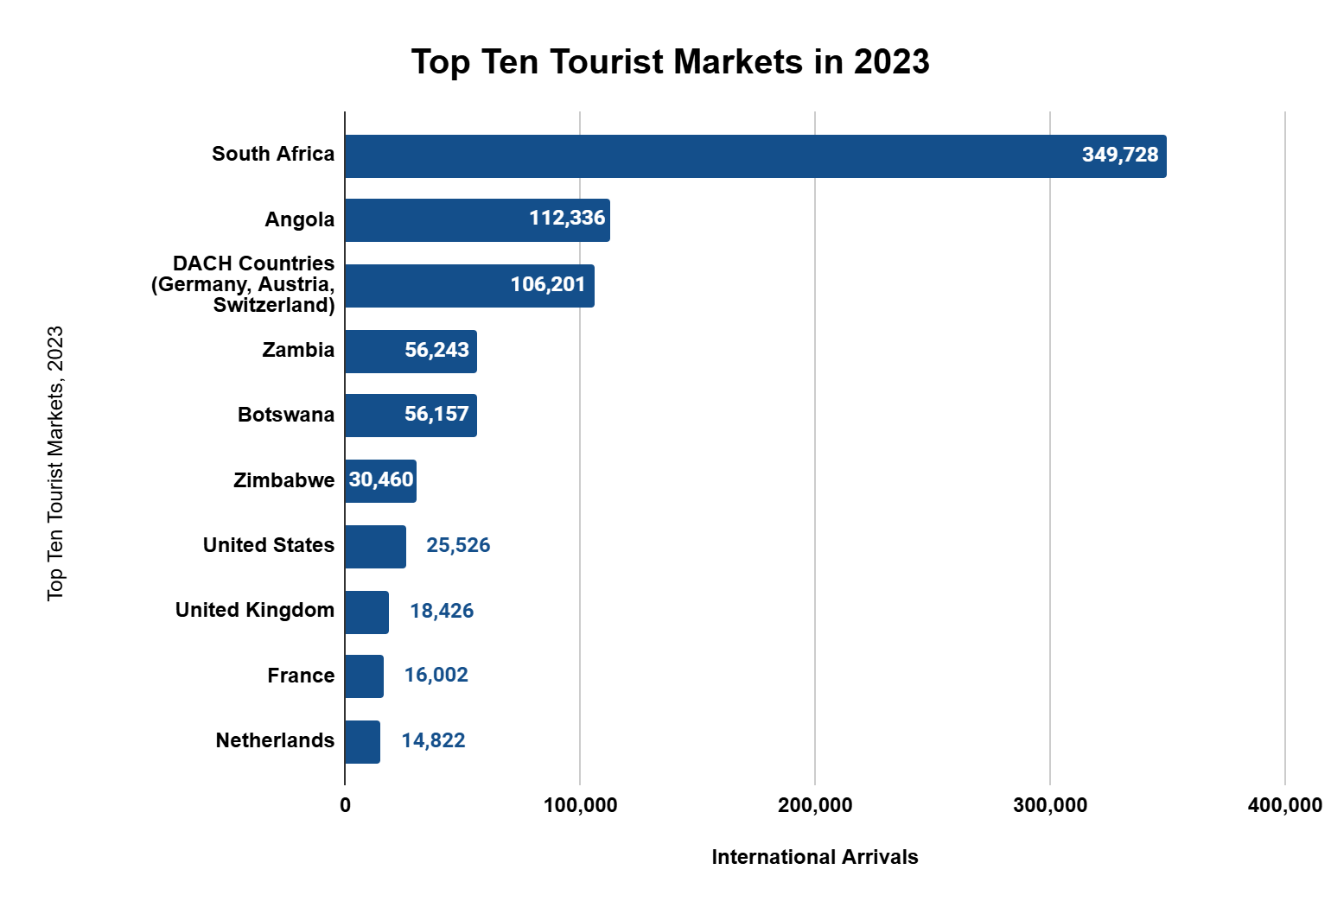
NAMIBIA TOP 10 ARRIVALS 2023
February 2024 = 37,207 passengers
8.1% month-on-month increase and 26.1% year-on-year
Exceeded pre-pandemic levels from February 2019 by 15.5%
Tourists from Germany, Austria, and Switzerland made up 40.9% of occupants
Similar trend in January 2024
Expected to persist through to start of high season
The top 10 tourism source markets accounted for a cumulative 80% of total arrivals to Namibia in 2023.

Slide 14
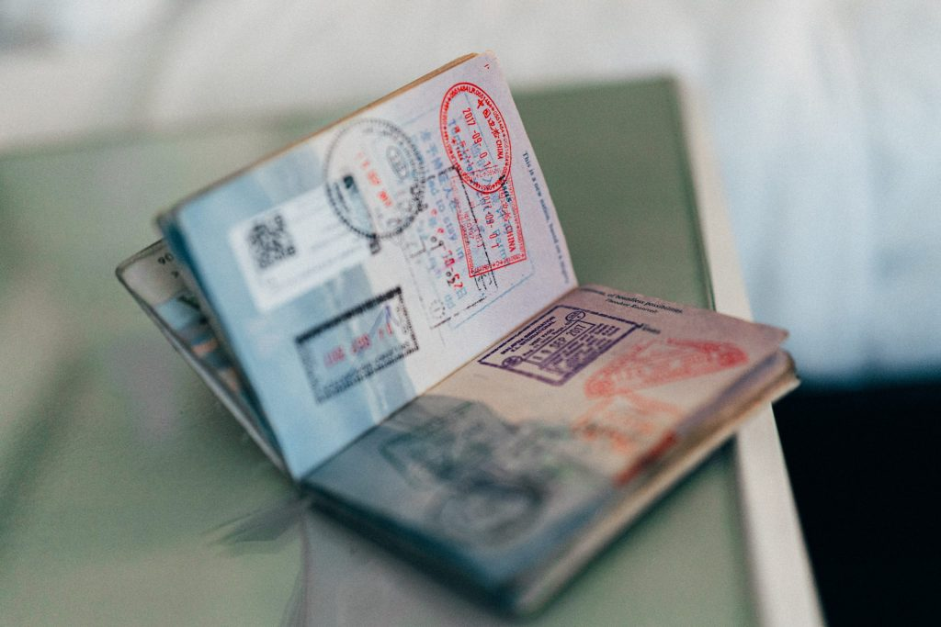
NEW VISA REGIME
E-visa and Visa-on-Arrival for countries without VISA Exemption Agreement effective 01 April 2025
Hosea Kutako international Airport
Walvis Bay International Airport
Oshikango Border Post
Trans Kalahari Border Post
Oranjemund Border Post
Noordoewer Border
Katima Mulilo Border Post
Impalila Island Border Post
Ngoma Border Post
Mohembo Border Post

Slide 15

NAMIBIA DIGITAL NOMAD VISA
Combined Tourist and Work Visa
6 Months
Digital Nomad Visa
Online Application

Slide 16
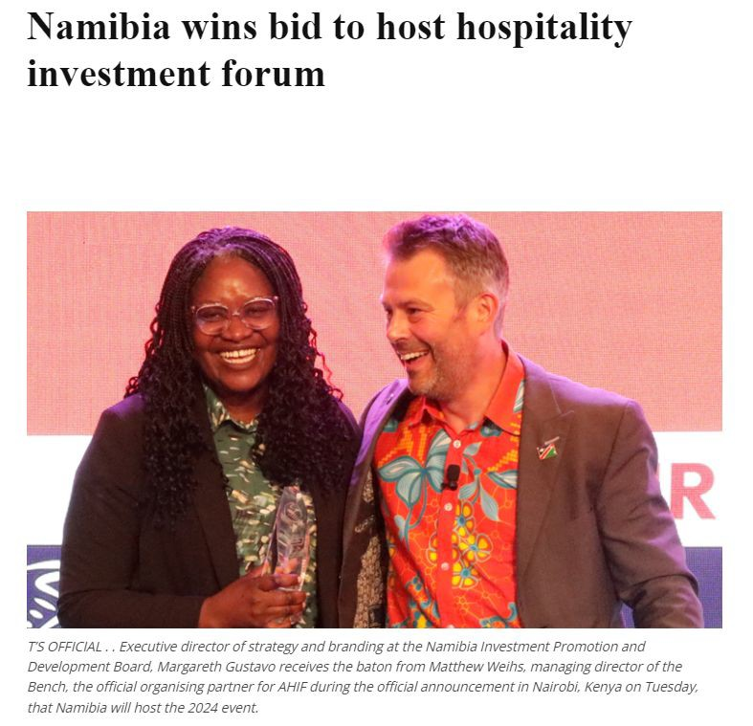
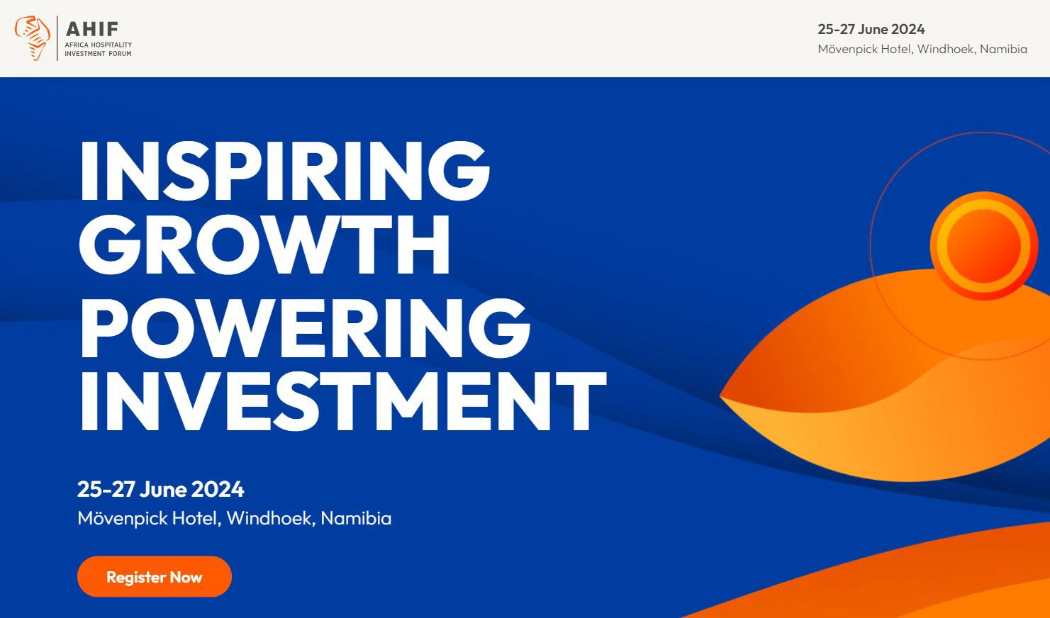
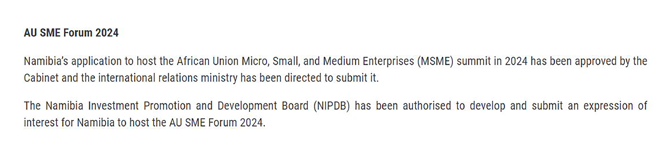
NAMIBIA’S VISION FOR A VIBRANT MICE INDUSTRY

Slide 17
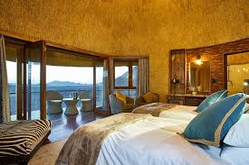
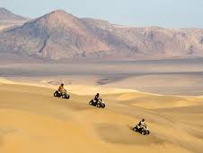
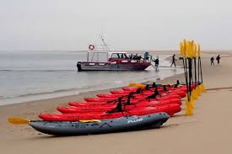
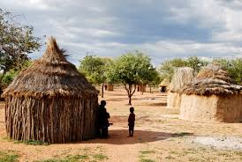

OPPORTUNITIES IN THE NAMIBIA TOURISM SECTOR
Sport Tourism
Namibia's diverse landscapes offer opportunities for various adventure sports especially in coastal areas like Swakopmund and Walvis Bay.
Infrastructure in Tourism
Road Infrastructure
Airport and Air Travel Infrastructure
Hospitality Infrastructure (lodges, hotels, etc.)
Digital Infrastructure (internet, telecommunications)
Port Infrastructure
Aqua Tourism
ECO - Tourism
Namibia presents exceptional opportunities for eco-tourism, built upon its commitment to conservation and its unique natural landscapes.
Creative and cultural Tourism
Namibia has beautiful landscapes and locations that have been featured on the big screen. it also has potential to grow its creative tourism where tourist would be able to learn traditional crafts, or art from local people.
Namibia's coastal environment presents a variety of aqua tourism opportunities, capitalizing on its unique marine ecosystems.

Slide 18
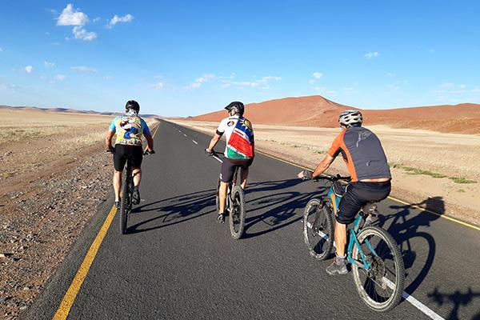
SPORT TOURISM: NAMIBIA HOSTS INTERNATIONALLY RECOGNIZED ENDURANCE EVENTS
Desert Ultra Marathons: Namib Race and Wildrun Namibia attract athletes from across the globe.
Mountain Biking: Races like the Desert Dash, a grueling 369 km bike race
Adventure Racing: Namibia’s vast wilderness is ideal for multi-discipline endurance races, combining running, cycling, and kayaking.
Triathlons and Swim Challenges: Coastal towns offer venues for triathlons and ocean endurance swims.
Notes:
Endurance sports in Namibia are experiencing a surge in popularity, influenced by the nation’s distinctive geography, and climate, and an increasing enthusiasm for outdoor and adventure activities.
The country’s expansive desert landscapes, rugged terrains, and varied ecosystems provide a unique setting for endurance athletes.

Slide 19






A DESTINATION FOR CELEBRITIES SEEKING TRANQUILITY AND SPACE
Lewis Hamilton
2022
Robert Lewandowski
2022
Jose Mourinho
2022
Gabrielle Union & Dwyane Wade 2022
Roger Federer
2019
Angelina Jolie & Shiloh 2006

Slide 20
NAMIBIA’S INVESTMENT ENVIRONMENT
Political Stability
Financial Sophistication
Established FDI Destination
Investor Protection
33 years of stable democracy & peace
Well developed financial & banking sectors & the 3rd largest pension
fund industry in Africa
Multiple long established &
successful foreign investments & companies
Freedom from nationalisation
Human Rights
Advanced Infrastructure
Logistics Hub
Investment Repatriation
Unamendable rights enshrined in the constitution, including right to private property
Stable telecoms, electricity & water supply & sanitation
High quality logistics infrastructure and competence (including regional & international land, air & sea
connections)
Freedom to remit capital and profits
Liberty
Accessible workforce
Natural Resources
Currency Convertibility
Free Market Economy, Freedom of the Press
An educated, job seeking, English speaking population that can be upskilled using a national training fund
Local and regional abundance of solar, wind, oil, gas, metal, mineral and agricultural resources
Protected currency
convertibility & Rand peg
Rule of Law
Quality of Life
Market Access
Dispute Protection
Established & functioning laws & regulations (including the
Foreign Investment Act)
Comfortable weather, short
commutes, quality schools, hospitals & entertainment
Several preferential trade
agreements, including the AfCFTA, EPA, AGOA & Mercosur
Equitable dispute settlement mechanisms

Slide 21
Thank You

