Slide 1

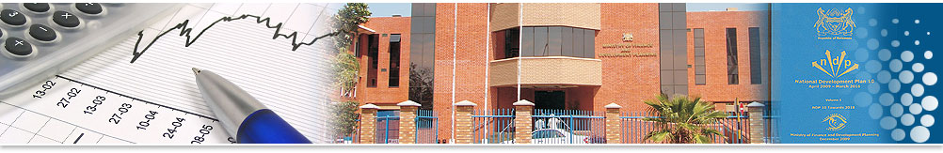
REPUBLIC OF BOTSWANA
Ministry of Finance
Recent Economic Developments
and Prospects

Slide 2
Contents
Global Economic Review
Domestic Economic Review
  Economic Growth
  Unemployment
  Inflation Developments
  External Sector Developments
  Foreign Reserves
  Diamond Prospects
  Fiscal Developments and Outlook
Tourism Developments
Macro-Fiscal Risks
Conclusion

Slide 3
Global Growth to moderate in 2025..
Global growth has slowed down in recent years due to a series of shocks which include persistent geo-political conflicts, recurring extreme weather events and high commodity prices.
The IMF has revised global growth prospects down to 2.8%. Global growth is expected to pick up 3% in 2026.
Global growth remail below the historical (2000–19) average of 3.7 percent.
All economic jurisdictions are expected to slowdown in 2025. Growth is expected to improve in 2026.
Asia remains one of the World’s primary growth engine
GDP growth forecast for 2025, %
Source: IMF
Notes:
China and India are expected to lead the pack in Asia with average growth of 4% and 6.2% over the next two years.
Economic activity is both these countries is key for foreign exchange inflows in BW either in the Mining Space and Tourism space

Slide 4
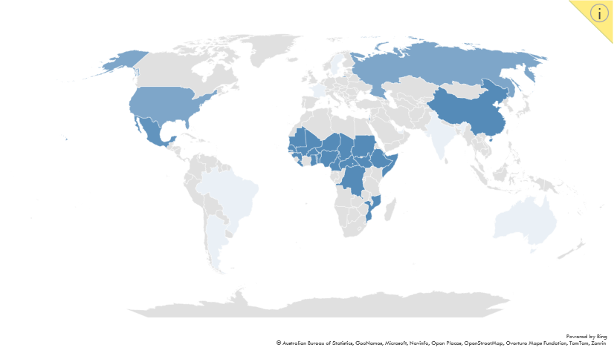
Geopolitical economics and hotspots
Russia/Ukraine
Conflict
Fiscal pressure in the West
USA
Relations with `China and Global Reciprocal Tariffs
Increased Global Trade fragmentation
Supply side disruptions
Global Inflationary pressures
Israel/Palestine
Conflict
Regional Conflagration,
Disruption in the Global Oil Market
China
Relations with US
Increased Global Trade fragmentation
Supply side disruptions
Global Inflationary pressures
Africa/Sahel Region
Political Instability
Regime collapse, terrorism spread
SADC (DRC/Mozambique)
Internal conflict
Regional Economic growth and trade corridor disruptions
Delayed AfCFTA implementation
Territory
Risk Type
Potential Impact
Notes:
Medium-term risks to the global economy are tilted to the downside, while the near-term outlook is characterized by divergent risks.
The world’s two largest economies, China and the United States caught up in restrictive trade policies
These policy-generated disruptions could interrupt supply chains and the easing cycle, with implications on Emerging Market Economies.
Persisting geo-political tensions

Slide 5
Botswana entered a technical recession in Q2-2024 on diamond weakness
Contribution to growth, ppt
Growth in 2024 was -3.0 percent compared to 3.2 percent in 2023
Largely due to the prolonged downturn in the diamond market.
This has resulted in a built up of inventories in the midstream – slowing uptake in the downstream activities;
Growth in non-mining-non-diamond sector has not been sufficient to offset the decline
Partly reflecting a lot of government footprint in the economy - which has crowded out private sector participation

Slide 6
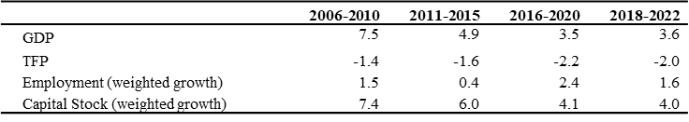
GDP growth forecasts positive but not “strong” enough while productivity is low…
The economy is projected to remain below potential in the medium term.
Reflects negative private sector TFP growth, suggesting…
Low efficiency in factors of production over time (L, K, Technology/efficiency).
…particularly employment and capital growth.
Lower efficiency in capital also suggests that capital accumulation has not been channelled towards productive investments with high rates of return to capital.
This inefficiency in the stock of capital has not been sufficient to create job opportunities.

Slide 7
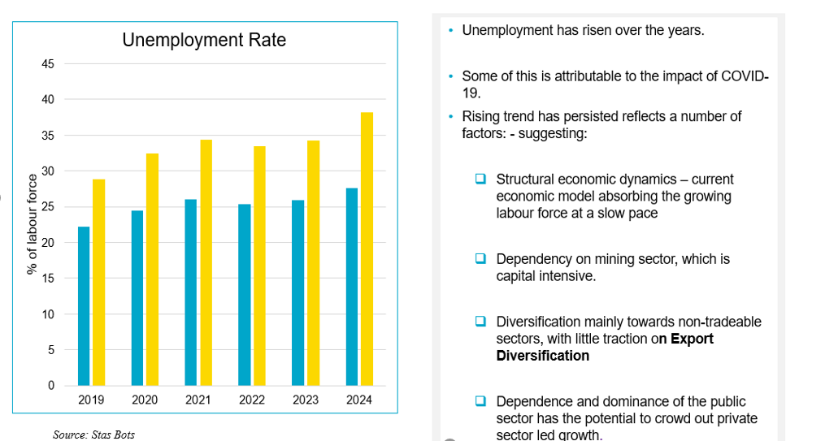
Unemployment remains a growing concern…
Unemployment has risen over the years.
Rising trend has persisted reflecting a number of factors: -
  Structural economic dynamics – current economic model is or running its course. There is need for new growth sources.
  Dependency on mining sector, which is capital intensive (diversification mainly towards non-tradeable sectors).
  Slow pace in absorbing growing labour force
  Dependence and dominance of the public sector has crowded out private sector led growth with negative TFP.
  Continued growth in this further reduces private sector competition and limits private sector growth and participation with implications for job creation

Slide 8
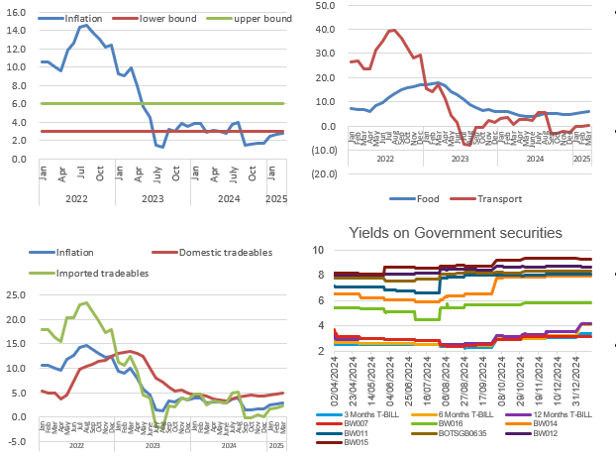
Inflation Developments …
The inflation rate has fallen from their historic highs in 2022.
  Reaching 2.8% in March 2025.
Inflation rate is expected to remain within the stability range of the Bank of Botswana objective range of 3-6% until 2025.
Monetary Policy Rate was reduced from 2.65 to 1.90 in April 2025.
Other market interest rates (Government securities) have however increased
Notes:
Increased by 0.1 percentage point to 2.8% in March 2025

Slide 9
Diamond Prospects: Uncertainty ahead – Mineral Prospects have been revised downwards since the latter part of 2023
Uncertainties emanating from measures imposed by G7 countries to enforce sanctions on Russian diamonds
.
Diamond price decline to clear inventory
Lower Consumer demand in major markets
Lab Grown diamonds continue to put pressure on natural diamonds
Divestment/demerge of Anglo American from De Beers, after a 98-year partnership
Diamond production reduced in 2025… affecting mineral revenue
higher-than-normal levels of inventory in the midstream market, reaching 16 million carats as at end of December 2024.
Reciprocal tariffs by the US on major diamond markets economies
Evolving consumer preferences

Slide 10
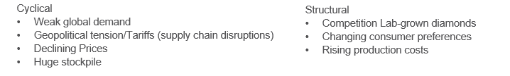
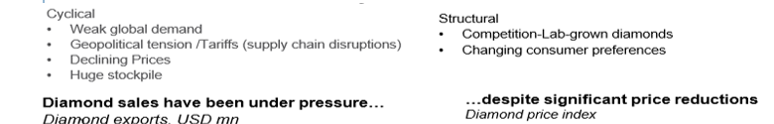
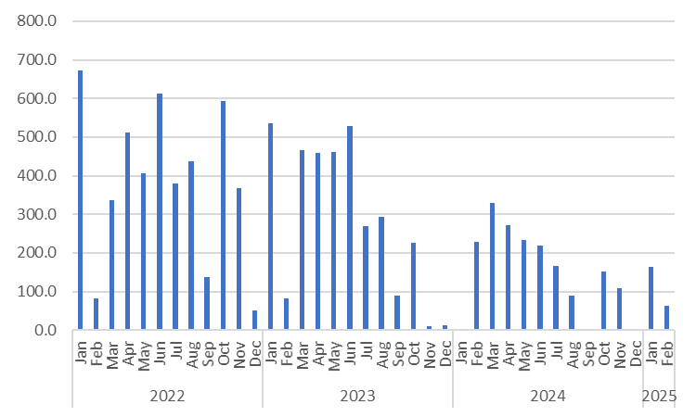
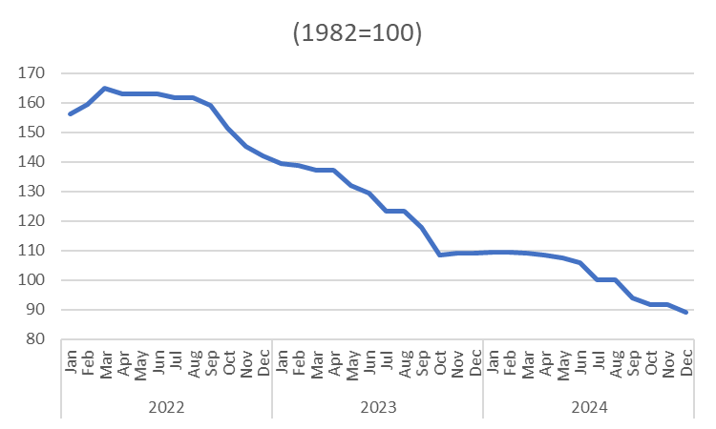
Diamond-sector weakness – Cyclical or structural?

Slide 11
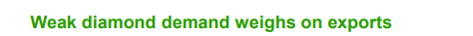
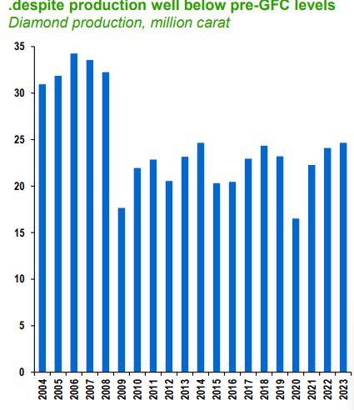
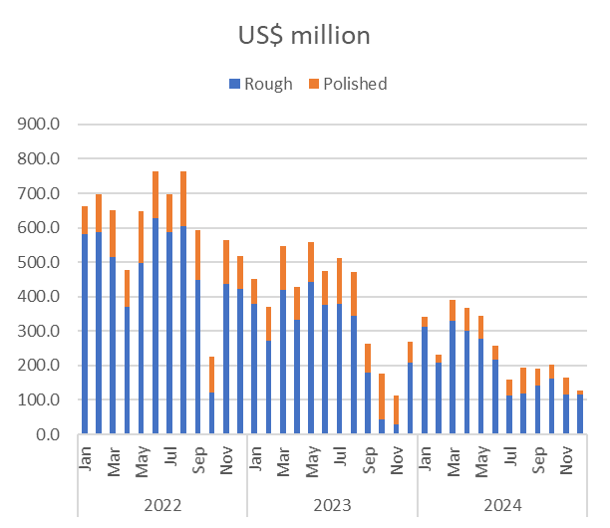
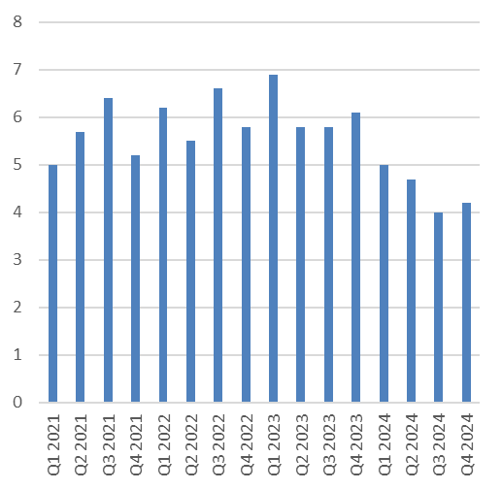
Diamond-sector weakness – Cyclical or structural?
Significant adverse impact on:
Fiscus – given the current expenditure pressures.
Balance of Payment position – given the low export diversification.
Foreign exchange reserves – Putting pressure on the current exchange mechanism which requires enough reserves to support the Peg.

Slide 12
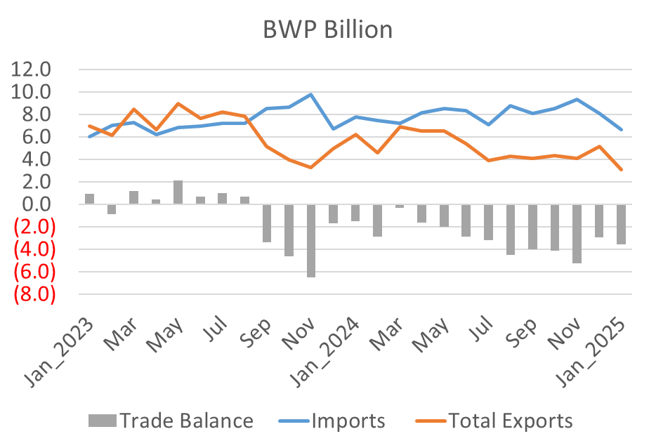
External position weakening on lower mineral receipts…
Trade Balance has been persistently in deficits
Trend could continue into the rest of 2025, given projected low diamond receipts with implications on revenue, foreign reserves…
…and budget – particularly development spending as much of raw materials for the Public Investment Programme is imported.

Slide 13
External position weakening on lower mineral receipts…
Foreign Reserves remain low by historical standards.
As at December 2024, the foreign exchange reserves stood at P48.1 billon or 3.5 billion US$.
This represents about 5.6 months of import cover of non-diamond goods and services
Low reserves comprising ability to cushion VS future shocks
Comprising sustainability of exchange rate regime

Slide 14
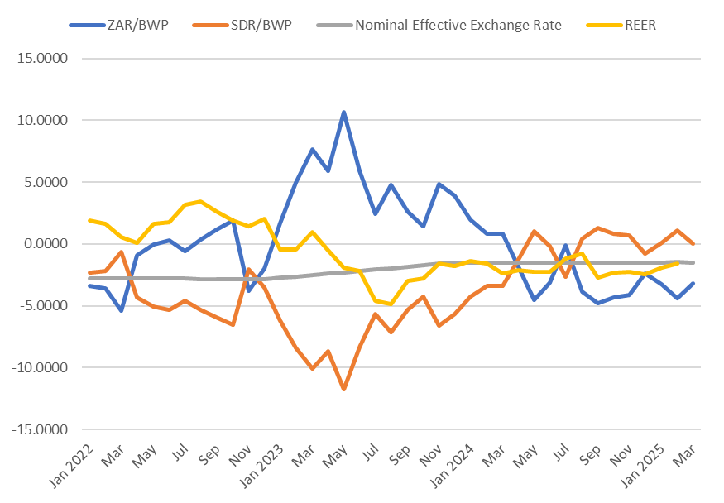
Lower Foreign Reserves putting pressure on Sustainability of Exchange Rate Policy…
In January 2025, Pula basket weights were changed to 50/50 (SDR/RSA), including implementation of an annual downward rate of crawl of 1.51 percent.
Nominal effective exchange rate (NEER) depreciated in line with crawl.
The real effective exchange rate (REER) depreciated by 1.6 percent in the same review period, suggesting a gain in Botswana’s export competitiveness, by this measure.
Overall sustainability of the current exchange rate framework is contingent on the adequate level of reserves needed to sustain the peg.
Notes:
REER depreciated due to the depreciation of the NEER (rate of crawl) and lower inflation in Botswana than in trading partner countries,

Slide 15
FISCAL DEVELOPMENTS & OUTLOOK

Slide 16
Fiscal position has deteriorated on lower revenue sources
Revenue Growth is largely Mineral Driven while wages dominate recurrent spending
Notes:
Diversifying Revenue sources is key to safeguarding fiscal sustainability. The importance of SACU revenues in the revenue mix is also critical now that mineral revenues are so low.

Slide 17
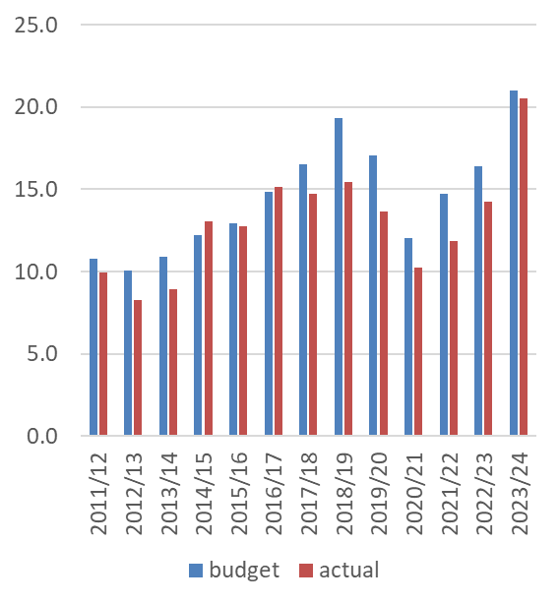
Fiscal position has deteriorated on inefficiency in spending
Development Budget consistently underspent – on average

Slide 18
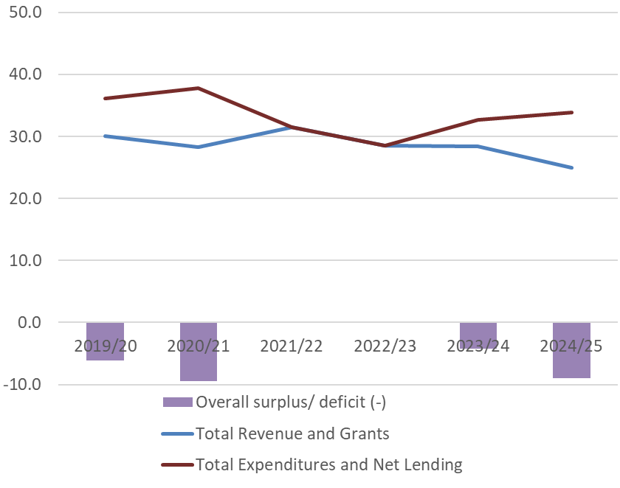
Overall fiscal balance trends (% of GDP)
Long-term downward trend in both revenues and spending – but faster decline for revenues.
Emergence of structural deficits.
Balanced budgets in 2021/22 and 2022/23
  But due to underspending on development budget – large deficits were planned.
There is also anticipation of budget deficits in 2024/25 and 2025/26.
Achievement of fiscal sustainability pushed further into the future.

Slide 19

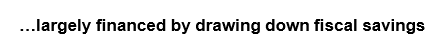
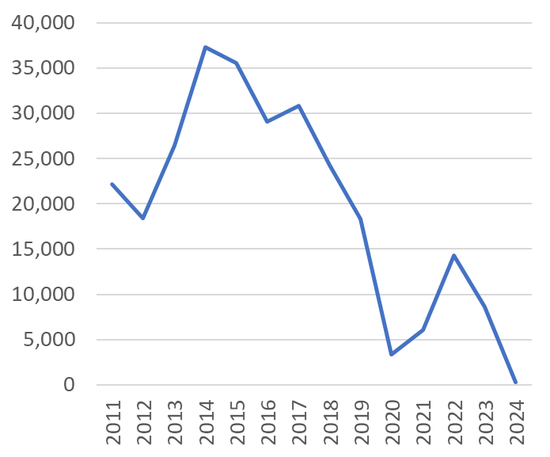
Fiscal position has deteriorated on more frequent deficits

Slide 20
Debt rising on lower buffers…

Slide 21
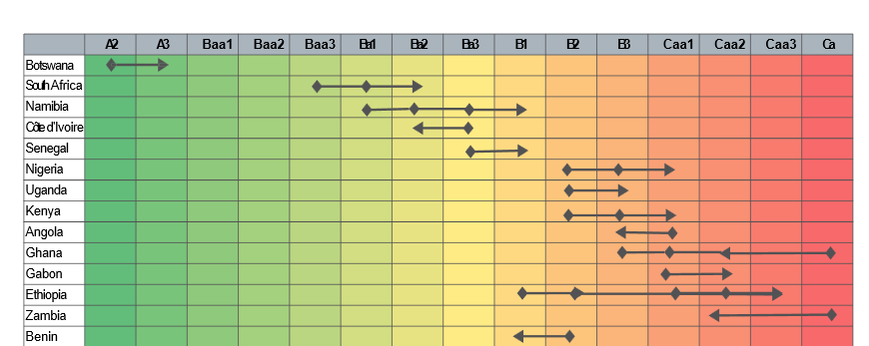
Botswana is the one of the highest-rated sovereign in Africa…
But this has been slowly deteriorating owing to increasing vulnerabilities
The outlook has recently been revised from stable to negative by both Moodys and S&P

Slide 22
TOURISM DEVELOPMENTS

Slide 23
Tourism sector performance
Accommodation and food services + travel agencies + air travel used as a proxy for tourism sector
One of the highest performing sectors of the economy
But contribution to growth remains weak
…with slowing growth over the past years

Slide 24
Tourism sector performance
The sector has not yet recovered from the scarring effects of COVID-19
Performance remains below pre-Crisis levels

Slide 25
External position vs ROW (Travel)
Scarring effects of COVID-19 also noticeable within travel services
Performance remains below pre-Crisis levels

Slide 26
Tourism Prospects
Prospects remain broadly stable and positive
Growth anticipated to remain above potential
But this remains low with room for much higher growth prospects

Slide 27
Tourism Prospects
A prolonged V-shaped recovery anticipated
The sector is not anticipated to recover to its pre-COVID levels at least until 2029

Slide 28
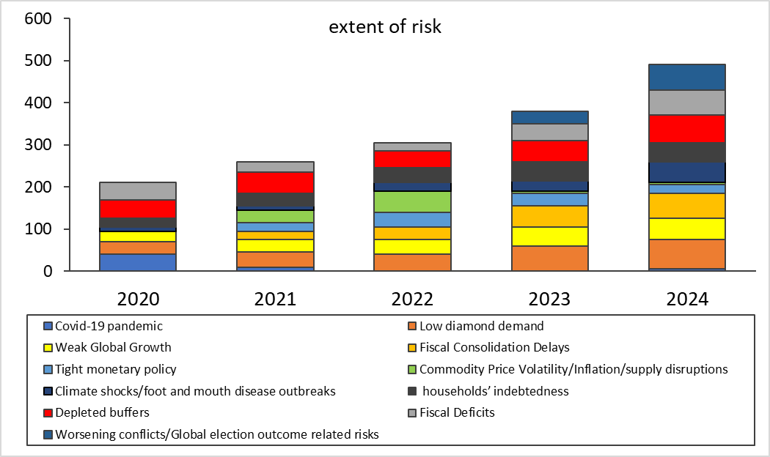
Macro-fiscal risks gradually building up
Despite recovery from COVID-19 and recent commodity price shocks, other risks to the domestic economy have been gradually building up.
The main risks are related to:
  uncertainty in the diamond industry
  Weak global growth
  depleted buffers
  widening fiscal and current account deficits
  steadily rising debt levels.
  Global Trade Wars
Notes:
depleted buffers (both fiscal buffers in the form of Government Savings in the Government Investment Account) and the external buffers in the form of (foreign exchange reserves). Largely demonstrating the impact prolonged twin deficits (Fiscal Deficits (Government is spending more that it is earns (in both tax and non- revenue) and Current Account Deficit ( where the country imports exceeds our exports)

Slide 29

AGENDA FOR REFORM:BUILDING AN INCLUSIVE AND DEEP ECONOMY
Phase 1
Halting the financial haemorrhaging in Government
Drive revenue maximisation and collection..
Strengthen oversight and regulatory institutions to address structural and market barriers.
Strengthen procurement model
Transform Government machinery.
Phase 2
Stabilization and preparation for take-off
Financial partner and Investor Framework.
Transforming SOEs into high performance organizations
Successful conclusion of De Beers Group negotiations.
Phase 3
Initial tangible steps of change
Diversify the economy (tourism, manufacturing, information technology).
Revamp low-income housing programme.
•Ramp up capacity to execute mega projects
Energy Sector a key driver for diversification
Phase 4
Building a New Botswana
Transform Creative Industry and Agriculture sector.
Creation of Sovereing Wealth Fund and National Fund of Funds.
Research and Development.

