Slide 1


Air Connectivity & Airport Infrastructure
HATAB Annual Conference
24 April 2025

Slide 2
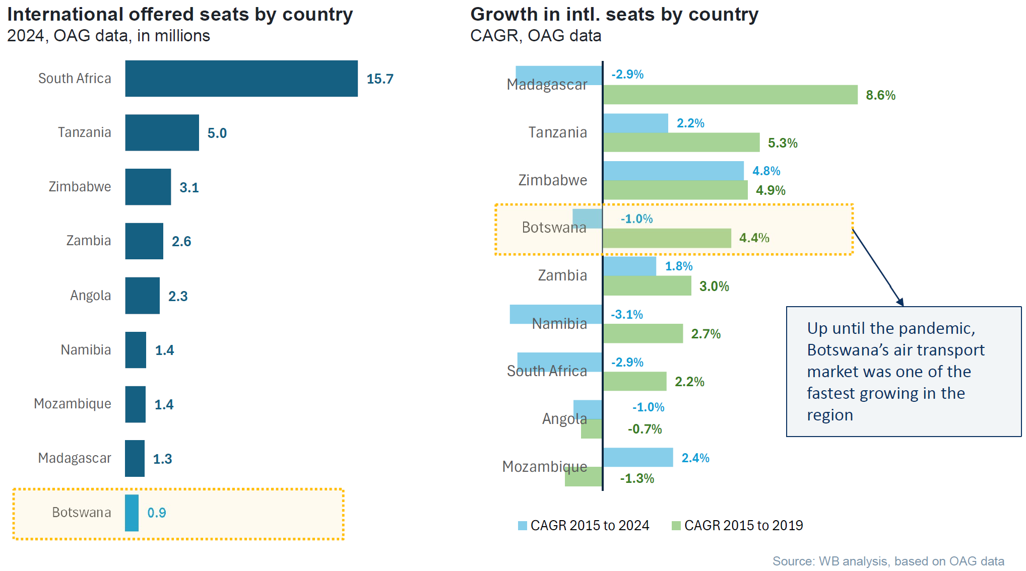
International Aircraft Seats Comparison - SADC
Financial Pre-Feasibility and Economic Benefit Assessment – The World Bank
2
2

Slide 3
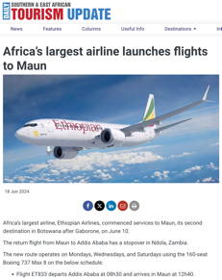
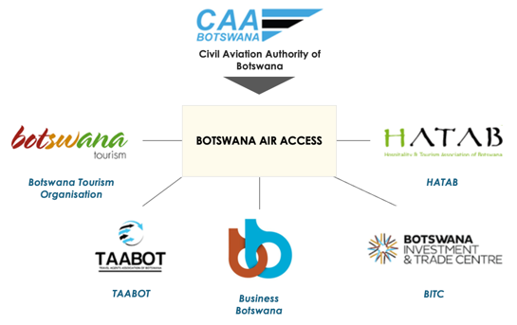
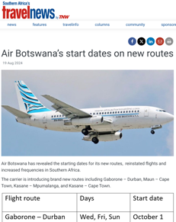
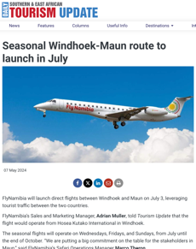
Botswana Air Access
Botswana Air Access was launched by The Civil Aviation Authoiurty of Botswana (CAAB) as a collaborative public and private sector initiative on 27 August 2024. Project stakeholders include Botswana Tourism Organisation (BTO), Business Botswana (BB), Botswana Investment and Trade Centre (BITC), Travel Agents Association of Botswana (TAABOT) and the Hospitality and Tourism Association of Botswana (HATAB).
Project Structure
2024-2025 International Network Developments
3
Terminal Building

Slide 4




Botswana Air Access ASD Pillars
Developed around four core principles, which emphasise effective engagement with carriers and providing them with the information that improves their decision-marking processes.
BOTSWANA AIR ACCESS ASD PILLARS
1
A SINGLE POINT OF CONTACT
The Botswana Air Access model consists of a wide range of stakeholders across the country that can provide carriers with a single point of contact and assistance during route development activities.
2
STAKEHOLDER COLLABORATION
Stakeholder collaboration is important as it allows for the pooling of both financial and human capital resources. Furthermore, it allows for a holistic destination offerings to carriers from a range of stakeholders that have a vested interest in growing our country’s connectivity.
3
PITCHING TO CARRIERS
Pitching to carriers at their HQ or at route development events such as Routes World or AviaDev is an important component of the overall route development process. It not only allows for effectively communicating Botswana’s business case but also allows for constructive engagement with carriers.
4
LEVERAGE BUSINESS CASES BEYOND AVIATION
Business cases presented to carriers provides them with robust tourism, economic, aviation and investment insights into our country, which have a material effect on the success of a potential route introduction or expansion.
4
Terminal Building

Slide 5
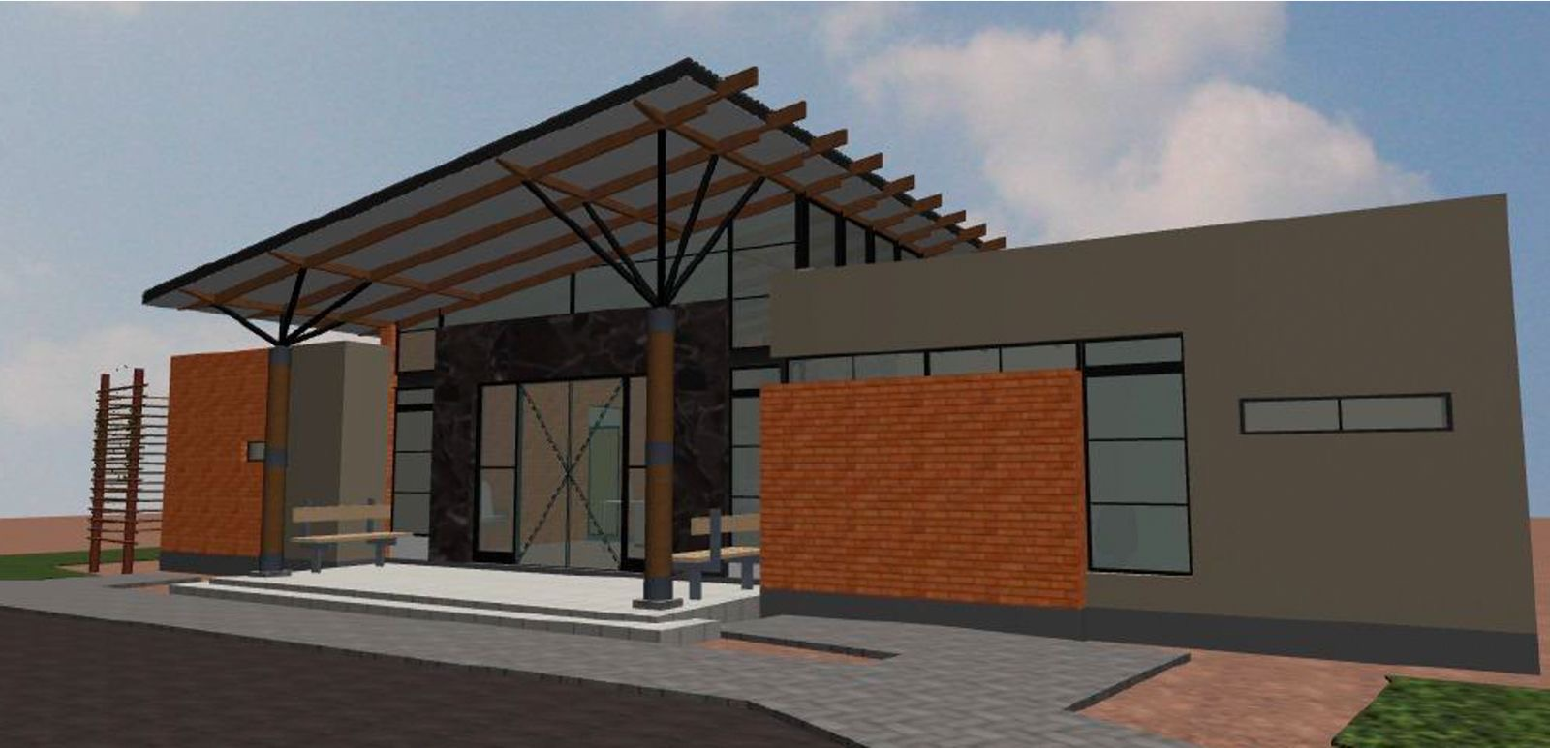
Airstrip Development
Perimeter Fencing
Runway
….and Palapye
5
Terminal Building

Slide 6
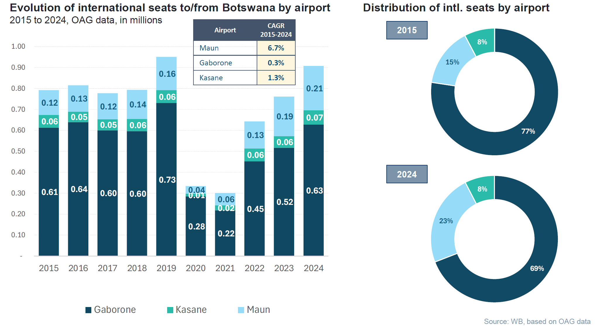
Growth Trends – International Seats
Maun has been Botswana’s fastest growing airport in the past decade - CAGR of 6.7% in intl. seats between 2015 and 2024
6

Slide 7
MUB Pavement Classification Rating
Concepts
ACN (Aircraft Classification number) characterizes the aggressiveness of the aircraft on the pavement
Provided by the aircraft manufacturer.
PCN (Pavement Classification number) characterizes the pavement bearing capacity. T
Published by the manager of the airport.
Review of the PCN
MUB pavement classification has been PCN 44/F/A/X/T
Capable of accommodating up to A320/B737 type aircraft
Updated pavement classification is PCN 60/F/A/X/T
Capable of accommodating up to A330 type aircraft
7

Slide 8
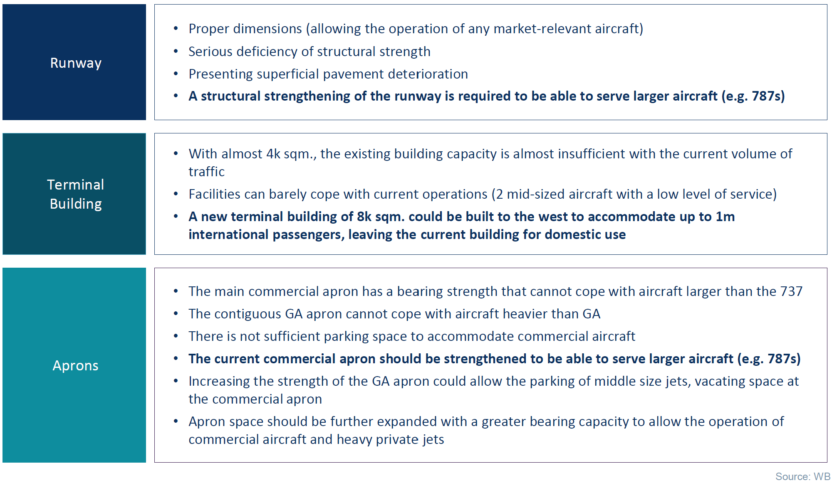
Potential Upgrades of MUB – World Bank Study
Execution of both movement area enhancement and new terminal building works (USD 102m)
8

Slide 9
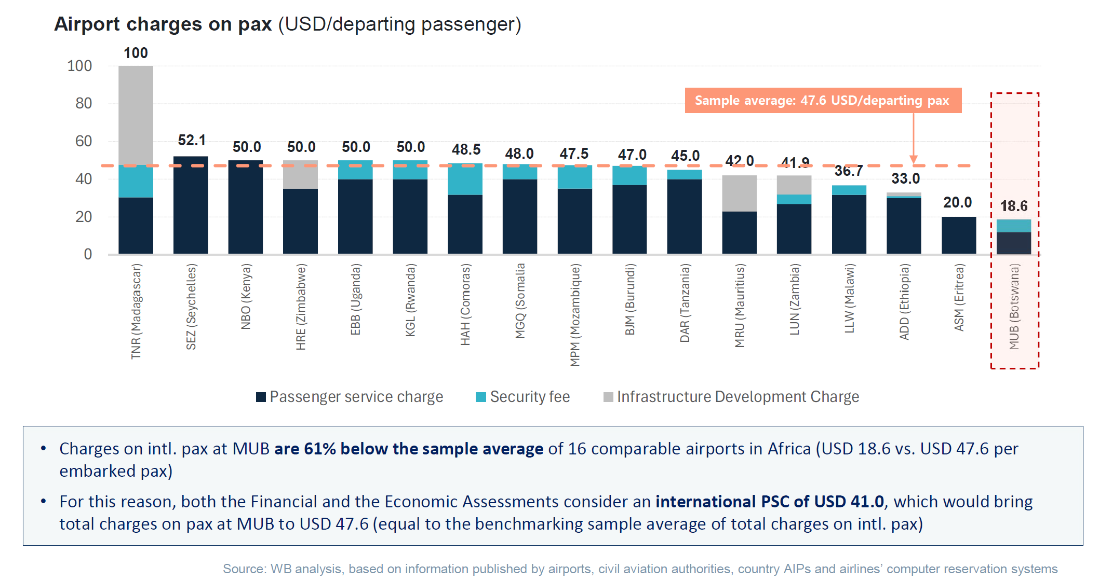
Passenger Fees - Benchmark Assessment
9

Slide 10
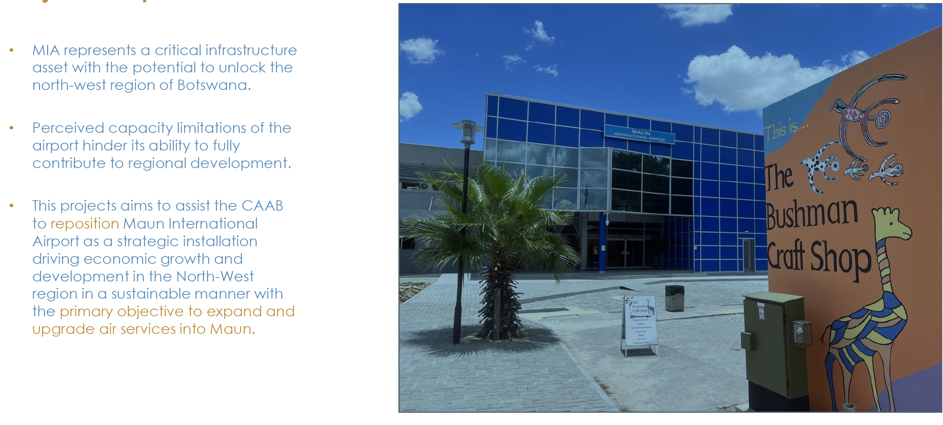
Maun International Airport Feasibility Study
10

Slide 11
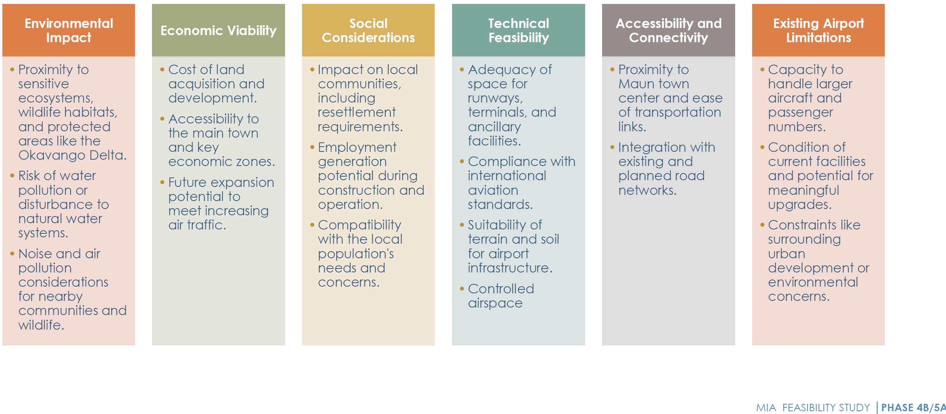
Alternate Sites
Criteria for Siting or Upgrading an Airport
Project at stakeholder engagement stage
11

Slide 12
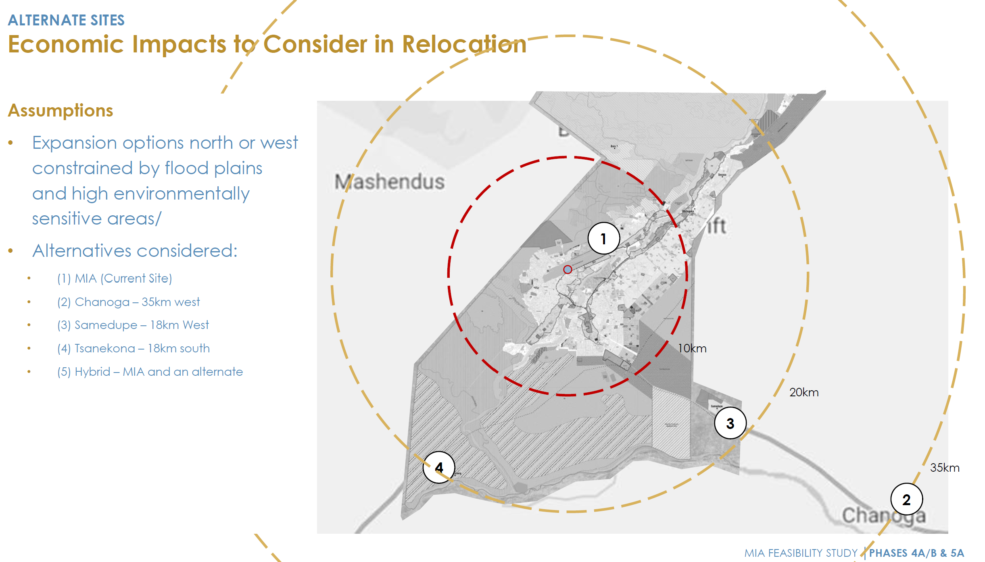
Site Assessment
east
east
12

Slide 13

Thank you...
13

