Slide 1
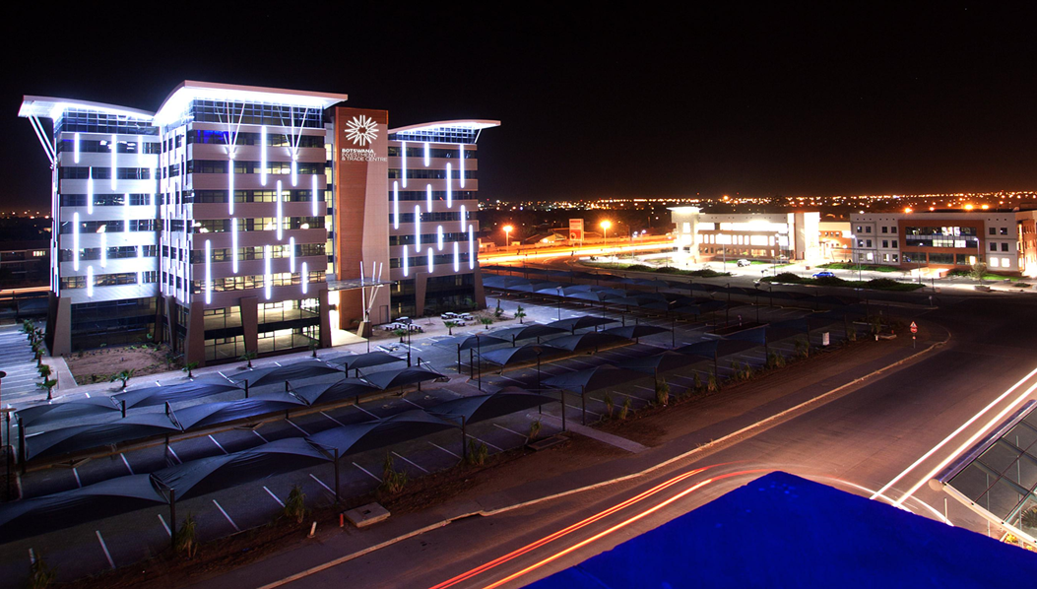
BITC CEO FACILITATING INVESTMENT IN TOURISM: April 2024 Maun

Slide 2
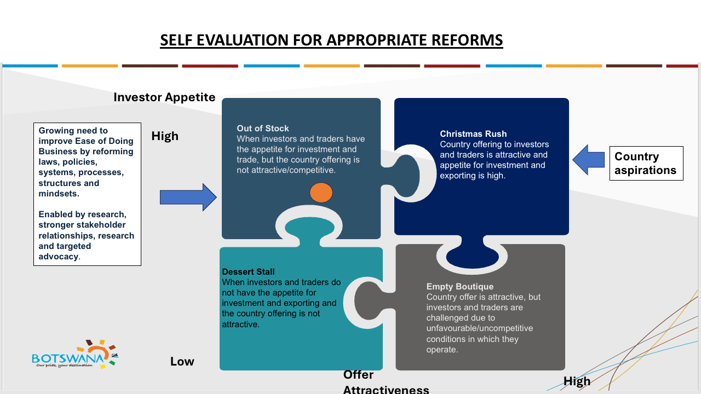

Slide 3




Global Tourism Status
Current Status
Before 2019, Tourism was world largest service sector at about 25% and 10.4% of global GDP (US$9 trillion);
COVID-19 resulted in about 50% loss in GDP contribution; 20% job losses and about US$ 1.3 trillion in revenue
There were 1.4 billion global tourists in 2024 according to World Tourism Watch (2024) by World Bank; this represented 11% more tourist (or 140 million ) more than in 2023;
Global Travel at about 99% of 2019 in 2024 before the advent of COVID -19
Outlook
Growth of about 3% to 5% globally expected – dependent of improving world economy and no escalations in current geopolitical tensions
This may have a positive impact of investment (new projects, expansions and commercial presences in some areas)

Slide 4
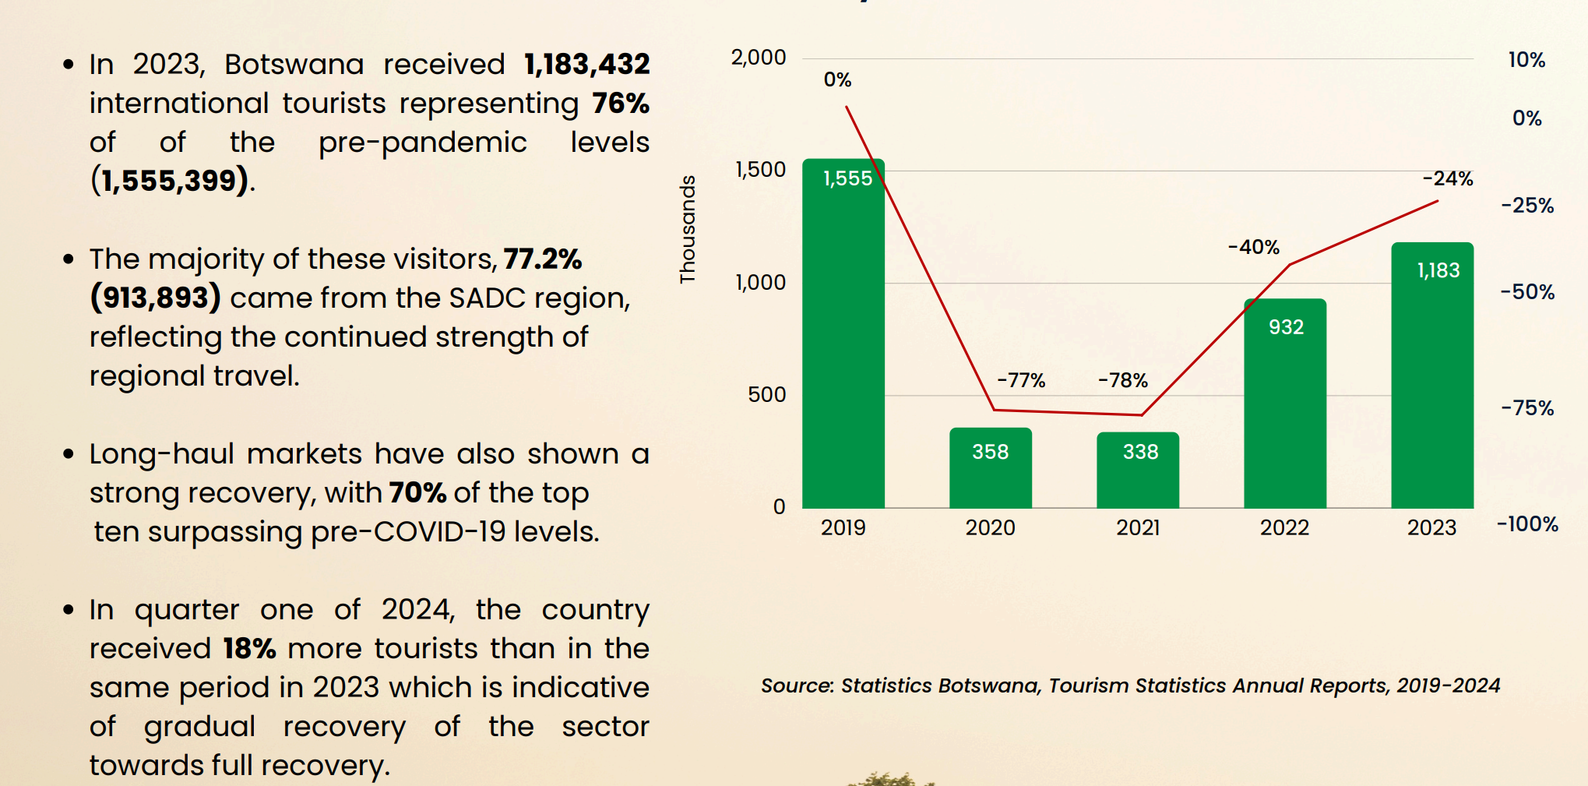
Botswana’s Arrivals Pre and Post COVID-19

Slide 5
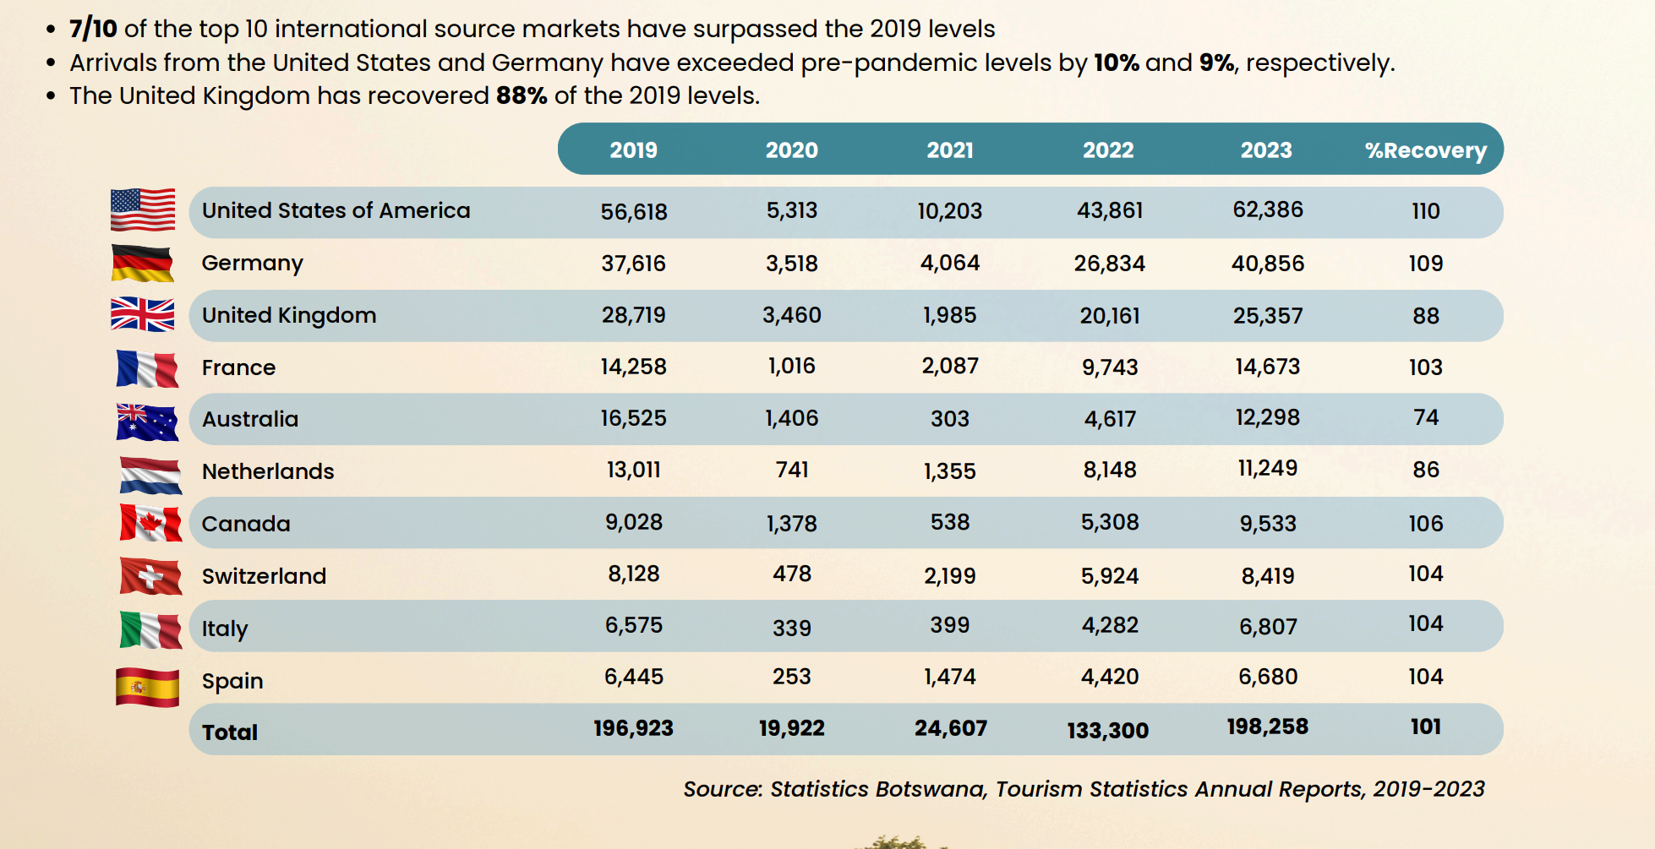
Botswana’s Top 10 Source Markets

Slide 6
MOTIVES & LOCATION DETERMINANTS FOR INVESTMENTS 2003-2023 Africa
These are also determinants of tourism investment for Botswana but BITC constantly scanning the environment for what could drive investment to Botswana in all sector including tourism.
Waveteq 2024

Slide 7
What Drives Investment in Tourism?
Driving Longterm Investor Confidence through:
Investors need clear, transparent and consistent policy frameworks.
Especially vital in areas such as land allocation for tourism development, tourism site concessions, clarity on tenure, renewal processes with clear timelines, environmental compliance with shorter timelines, and clear licensing processes.
Overall, clear timelines and criteria create certainty and therefore critical.
Streamlined investment process, minimal redtape, and time-efficient decision-making drive confidence.
BOSSC: Offer seamless support to investors.
Natural & Cultural Assets: Botswana’s comparative and competitive advantage lies in its unique and untapped eco-tourism offerings, cultural heritage (The Delta, Kalahari, heritage sites – Tsodilo Hills, Old Mines Sites), Sports.
Investors seek destinations with untapped potential and exclusivity.
Predictability and Clarity of Policy
Ease of Doing Business
Comparative and Competitive Advantage

Slide 8
What Drives Investment in Tourism?
Driving Longterm Investor Confidence through:
Botswana’s Economic Stability: Low corruption, political stability, and prudent fiscal management make it attractive.
Critically important to maintain this reputation.
Investors are attracted by competitive and well-designed incentives.
E.g. The Botswana International Financial Services Centre (IFSC) offers opportunities for structuring tourism funds.
Economic Stability
Incentives

Slide 9
Botswana’s Value Proposition in Tourism Investment
01
02
Pioneers of Sustainable Tourism: Low Volume High value
Unmatched Wildlife Adventures: rare birds, big 5, diverse eco-ecosystem
4th Most Visited Country in 2024 in Africa
Source: Tourism and Travel Index 2024
03
04
Rich culture and heritage. Eg Tsodilo Hills
Public Safety and Political Stability

Slide 10
Recommendations for Investment Promotion
Promoting Botswana as a MICE Destination
Key Leverages /Enablers
MICE Strategy of 2023
A tool for economic diversification and growth;
Leverage on natural resources endowment;
A historical experience in conservation;
Geo-strategic location in SADC and Africa;
Value addition to tourism industry to achieve more income generating; and
Profiling of projects under BITC project origination initiative – for projects-based investment promotion
New and Emerging Opportunities: Medical Tourism, sport tourism, agro-tourism, development of lesser known local destinations among others.

Slide 11
Creating A Conducive Environment
Need for a win-win model that combines Citizen Economic Empowerment (CEE) with openness to FDI .
Promote CEE: CSI, Equity, skills development, and local sourcing/ procurement quotas.
FDI attraction: provides both the capital and expertise required.
Air Access: Open sky policies, and partnerships with more airlines to regional/international routes.
  Develop new airstrips and expand existing ones, dev. other regional airports
Road Networks: Linking tourism sites to urban centres and transit corridors will improve connectivity and reduce transit time e.g. Kazungula Bridge.
  Need for similar investments for Kalahari Transfrontier/ Corridor (PPP-driven)
Utilities: Reliable power supply, water and ICT infrastructure are key enablers of modern tourism investment.
Balanced Empowerment and FDI
Infrastructure & Connectivity

Slide 12

Tourism Investment Facilitation: BOSSC @ BITC
ONLINE Company & Business Registration
Opening of Bank Accounts
 | Entry Visas, Work &
 |  | Residence Permits &
 | Exemptions
Trade & Business License Applications
Utility Connections
Income Tax & VAT Registration
Industrial & Commercial Land / Factory Shells
Incentives; IFSC, Manufacturing, Tax Holidays (DAO)
Aftercare Services – renewals, expansions etc.
Environmental Impact Assessment Compliance
Leveraged on strong Advocacy and Recommendations for doing business reforms

Slide 13
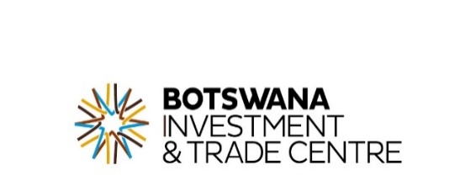
THANK YOU
Twitter: @Go_Botswana | Facebook & LinkedIn: Botswana Investment and Trade Centre
Contact # Head Office +267 3633301
Francistown Office: +267 3633343
www.gobotswana.com

